Slide 1
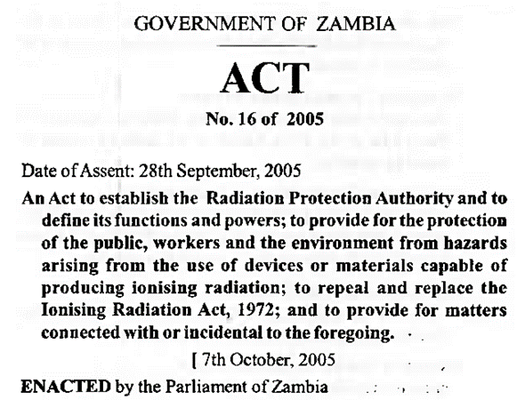
Medical equipment standards in Zambian hospitals
Application of Radiation Protection Board standards during the life cycle of x-ray equipment
Zambian Bureau of Standards standards during life cycle of scales
17.5.7 Medical equipment standards in Zambian hospitals
17.5.7 The usefulness of standards in Zambian hospitals is clearly explained, and examples of scenarios in which they would be helpful are provided.
Unit C 17.5 Adhering to Medical Equipment Standards
Module 279-17-C Regulations, Standards and Ethics
©
dr. Chris R. Mol, BME, NORTEC, 2015

Slide 2
Zambia Bureau of Standards for Safety and Quality Standards
The Zambia Bureau of Standards (ZABS) is the Statutory National Standards Body for Zambia established under an Act of Parliament, the Standards Act, Cap 416 of 1994 of the Laws of Zambia for the preparation and promulgation of Zambian Standards
ZABS is a specialized organization of National importance serving the country in the field of standardization, standards formulation, quality control, quality assurance, import and export quality inspections, certification and removal of technical barriers to trade.
http://www.zabs.org.zm/
©
Standards in Zambia
dr. Chris R. Mol, BME, NORTEC, 2015

Slide 3
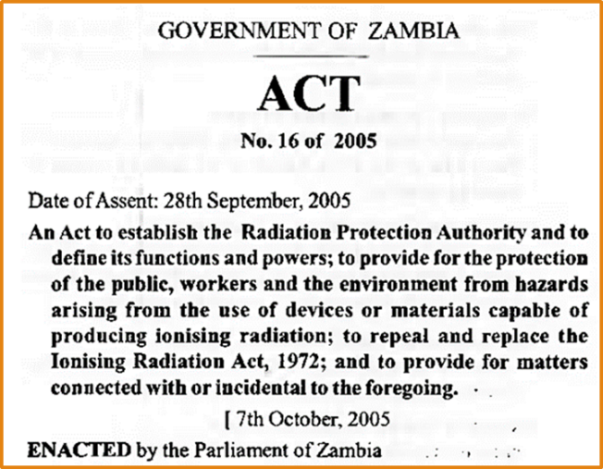
Radiation Protection Board: Standards for X-ray equipment
©
Standards in Zambia
dr. Chris R. Mol, BME, NORTEC, 2015

Slide 4
Zambia Ionizing Radiation Protection Act, 2005
Part II: establishes a Radiation Protection Authority, with a Radiation Protection Authority Board
consisting of 19 members, mostly representatives of various ministries
main tasks:
advise government on policies, etc. related to radiation protection
implement government policies related to protection of public, workers, etc.
issue licenses and authorizations
the board shall meet at least once every three months
decision making is by majority of members present
participants are not allowed to communicate on information that is acquired in this function
a selection of items only…
©
Standards in Zambia
dr. Chris R. Mol, BME, NORTEC, 2015

Slide 5
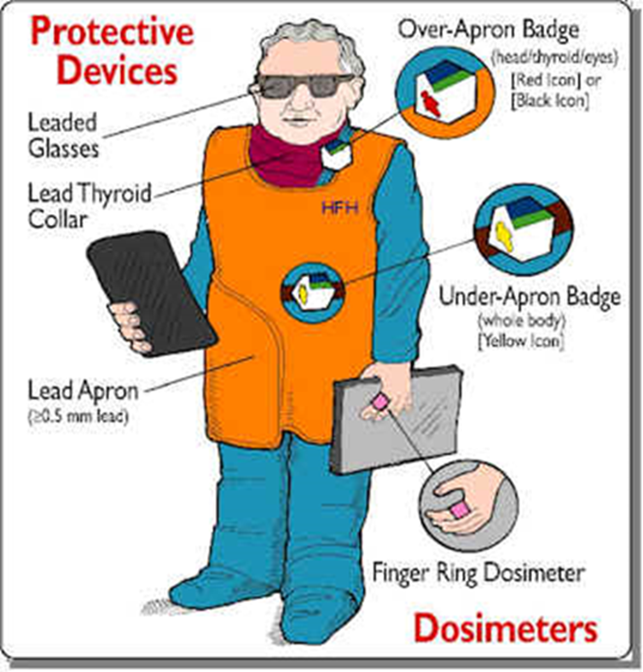
Zambia Ionizing Radiation Protection Act, 2005
Part III: The Secretariat
will implement decisions of the board
will set Radiation exposure limits
shall maintain a personnel radiation dosimetry service
to provide personal radiation measuring devices to be worn by an individual likely to be exposed to radiation
to provide a reporting service…. adequate records of personal radiation exposure measurements
warn the public in case of actual or potential radiation exposure …
monitor imported and local food stuff to detect any contamination with radioactive material
conduct assessments of radioactivity in underground mines …
an Executive Director will be appointed; (s)he is Secretary of the Board
©
Standards in Zambia
dr. Chris R. Mol, BME, NORTEC, 2015

Slide 6
Zambia Ionizing Radiation Protection Act, 2005
Part IV: Licences
anybody dealing with radio-active materials (etc.) shall to apply to the Board for a license
the radiation safety requirements prescribed by this act
do not extend to patients undergoing medical treatment by exposure to radiation by or under the supervision of a medical practitioner if such treatment is in accordance with and approved code of practice established by the relevant medical professional bodies
do apply to the safety of medical and technical staff working with the radioactive material or source of harmful ionising radiation and to the protection of all other persons, other than the patient undergoing treatment.
every licensee shall appoint a competent person as radiation protection officer, who shall liaise with the Secretariat to ensure compliance with the Act.
where a licensee intends to decommission an ionising radiation device, the licensee shall, at least six months before decommissioning the device, inform the Executive Director….
a selection of items only…
©
Standards in Zambia
dr. Chris R. Mol, BME, NORTEC, 2015

Slide 7
Zambia Ionizing Radiation Protection Act, 2005
Part VI: Inspections
the Board shall appoint radiation safety officers to monitor, inspect and enforce the provisions of this Act.
A radiation safety officer shall have power at all reasonable times to enter, …., to take samples of materials, take measurements, ….
a selection of items only…
©
Standards in Zambia
dr. Chris R. Mol, BME, NORTEC, 2015

Slide 8
Standards in Zambia
Further health related standards in Zambia:
metrology on weights and scales
Regulations on Medicines
©
Standards in Zambia
dr. Chris R. Mol, BME, NORTEC, 2015

Slide 9
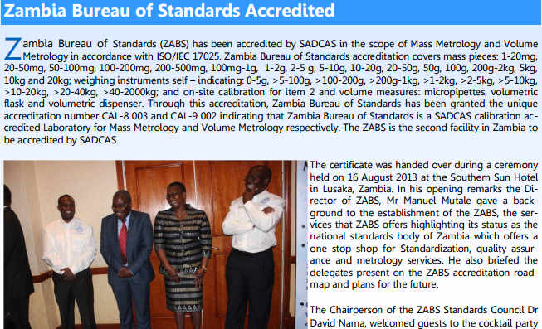
Zambian Bureau of Standards: standards during life cycle of scales
©
Standards in Zambia
dr. Chris R. Mol, BME, NORTEC, 2015

Slide 10
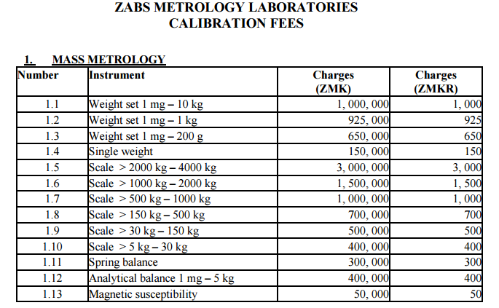
Zambian Bureau of Standards: standards during life cycle of scales
http://www.zabs.org.zm/
©
Standards in Zambia
dr. Chris R. Mol, BME, NORTEC, 2015

Slide 11
Zambia Medicines Regulatory Authority
The Zambia Medicines Regulatory Authority formerly the Pharmaceutical Regulatory Authority is the Statutory National Medicines Regulatory Body for Zambia established under an Act of Parliament, the Medicines and Allied Substances Act No. 3 of 2013 of the Laws of Zambia to regulate and control the manufacture, importation, storage distribution, supply, sale and use of medicines and allied substances.
http://www.zamra.org.zm/
The main objective of the Authority is to ensure that all medicines and allied substances being made available to the Zambian people consistently meet the set standards of quality, safety and efficacy.
©
Standards in Zambia
dr. Chris R. Mol, BME, NORTEC, 2015

Slide 12
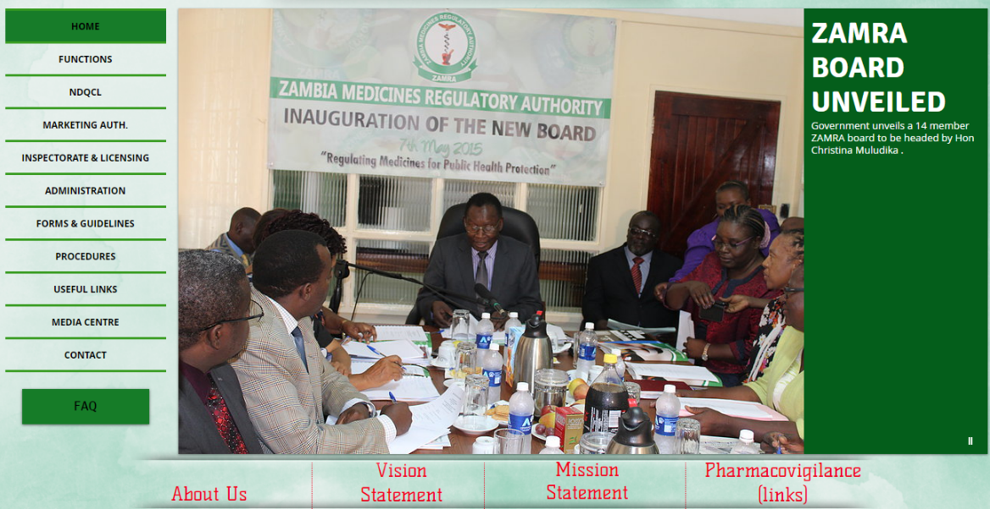
Zambia Medicines Regulatory Authority (2015-05-07)
©
http://www.zamra.org.zm/
Standards in Zambia
dr. Chris R. Mol, BME, NORTEC, 2015

Slide 13
Further development / adoption of standards for Med. Equipment in Zambia…
Set up community….. (association ?)
©
Standards in Zambia
dr. Chris R. Mol, BME, NORTEC, 2015

Slide 14
END
The creation of this presentation was supported by a grant from THET:
see https://www.thet.org/

